Slide 1

Motion Blur
---Tianshi Xie

Slide 2
Introduction
What’s the motion blur?
How does it work?
How to implement the Motion Blur?

Slide 3
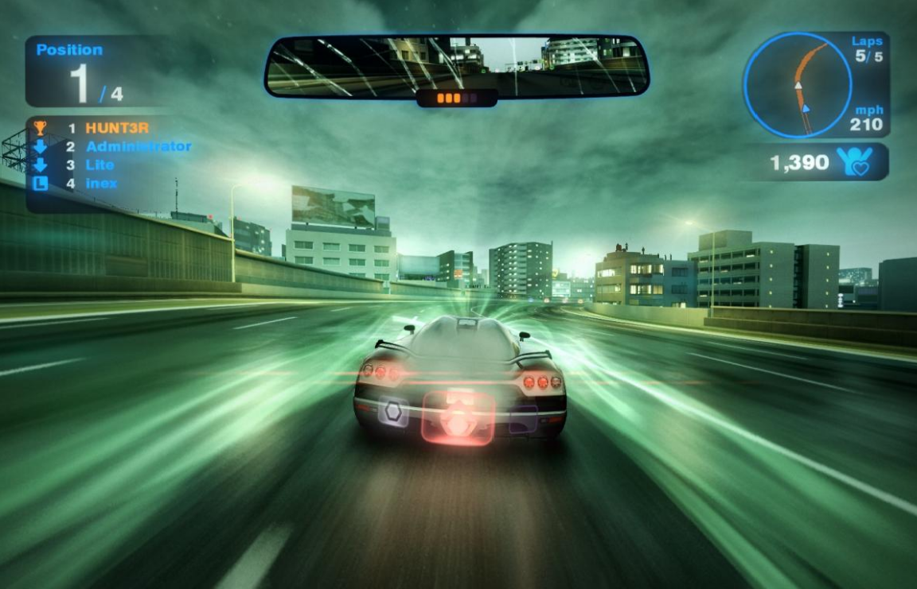
What’s the motion blur

Slide 4


What’s the motion blur?

Slide 5
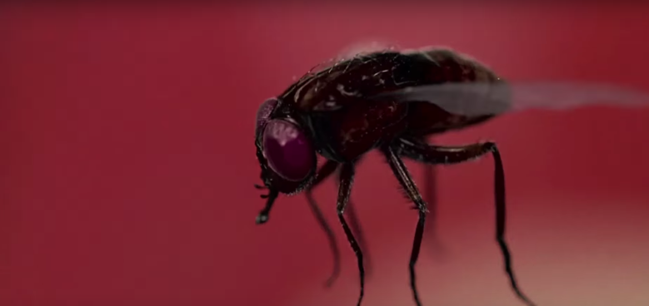
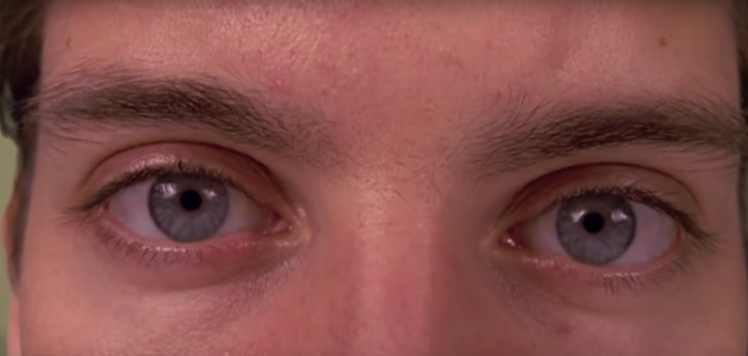
How does it work?

Slide 6
How to implement the Motion Blur
Object Motion Blur
Camera Motion Blur.

Slide 7
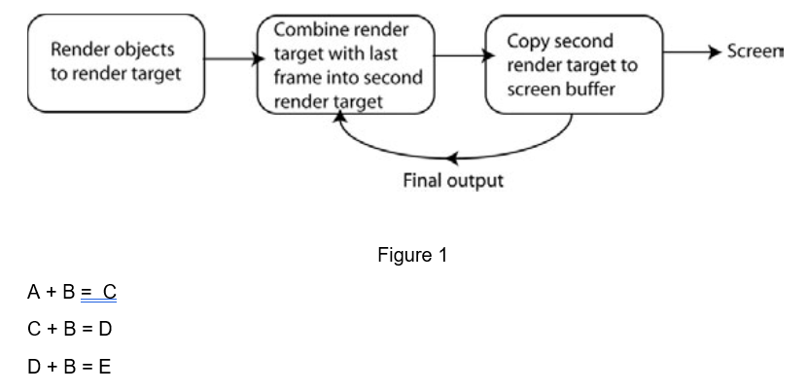
Object Motion Blur

Slide 8
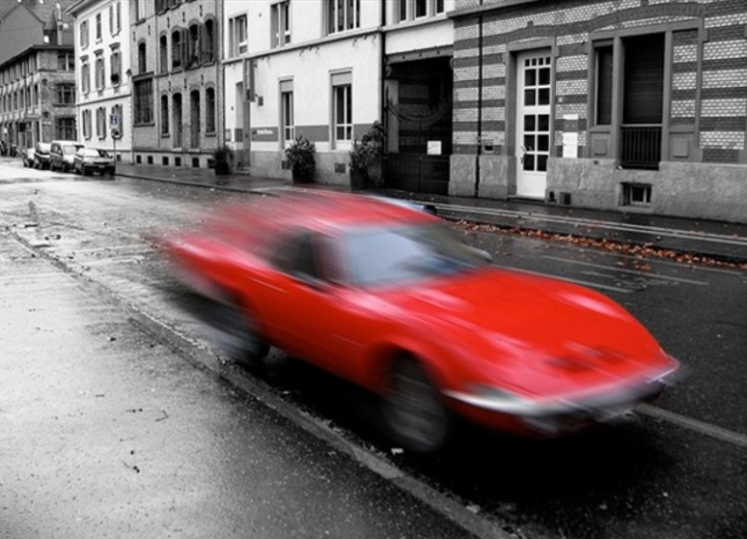
Object Motion Blur

Slide 9
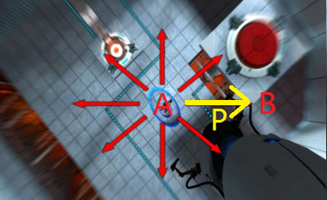
Camera Motion Blur
B = B + Offset
P = B - A
Offset = Normalize(P) + Noise
Figure 2

Slide 10
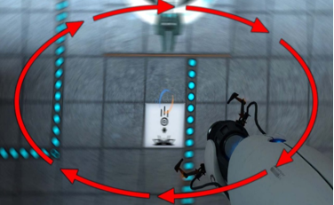

Camera Motion Blur
B = B + Offset
Figure 3

Slide 11




